Slide 1
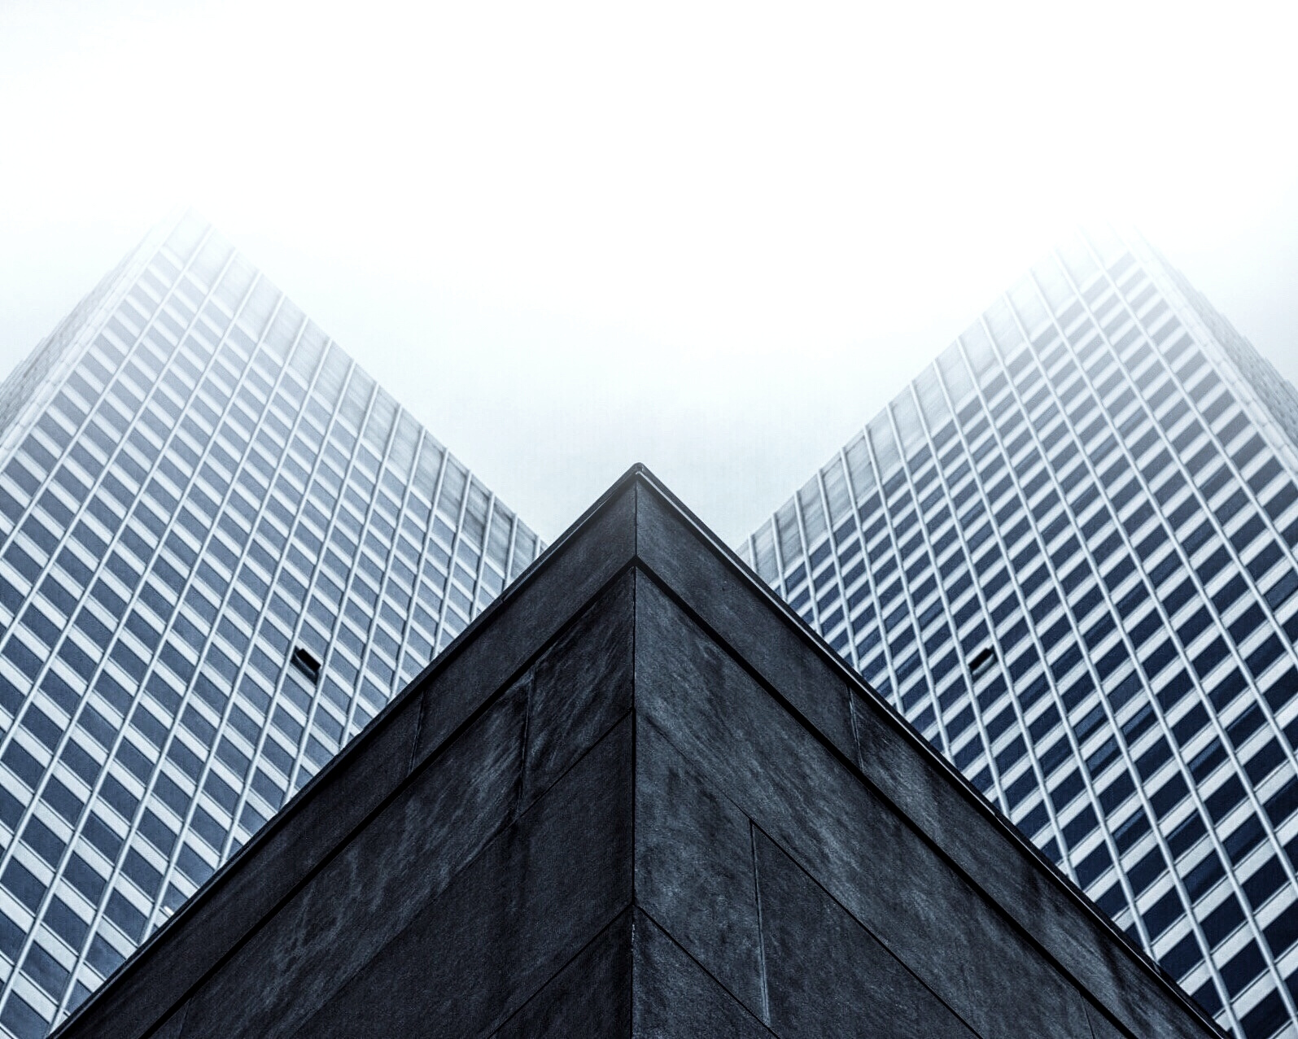

PROJECT:- Face Detection & Recognition System on Images
Group Members:-
Kunal Verma (1900820100063)
Nipurn Sinha (1900820100097)
Mohd. Zaid Ullah Khan (1900820100089)
Priyanshi Varshney (190082000110)
MINI PROJECT IN
MACHINE LEARNING PROJECT

Slide 2
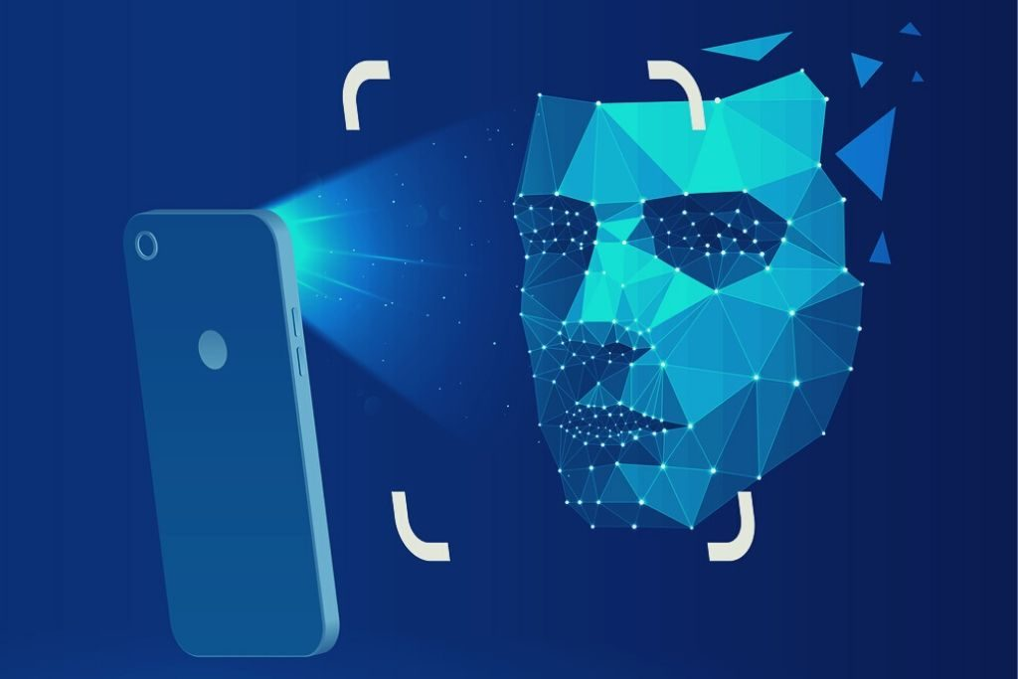
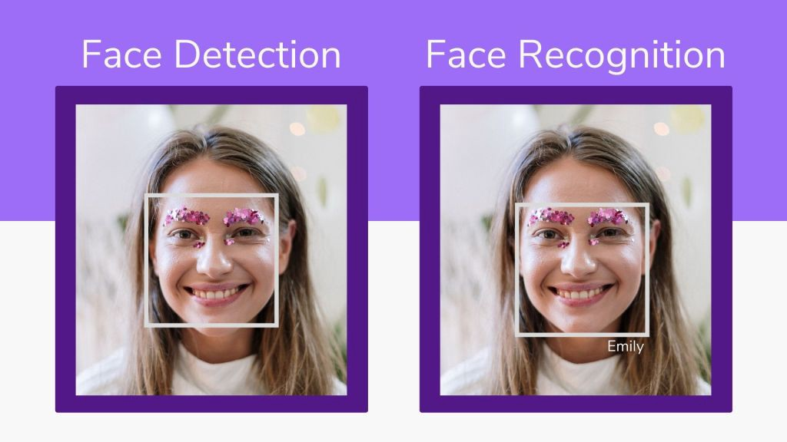
FACE DETECTION
Face detection -- also called facial detection -- is an artificial intelligence (AI) based computer technology used to find and identify human faces in digital images.
FACE RECOGNITION
A facial recognition system is a technology capable of matching a human face from a digital image or a video frame against a database of faces, typically employed to authenticate users through ID verification services.

Slide 3


Uses of Face Detection
Face detection can also be used to auto-focus cameras. The technology also has marketing applications -- for example, displaying specific advertisements when a particular face is recognized.
An additional use is drawing language inferences from visual cues, or "lip reading”.
Uses of Face Recognition
User ID Verification,
Used Authentification in smartphones.
Detecting specific facial structures in large crowds.

Slide 4
REQUIREMENTS
1. Hardware :-
4 GB RAM
1GB HDD
Dual Core Processor
Webcam or any in-built camera.
2. Software:-
OpenCV installed on system
Keras installed on system
Python 3.0+

Slide 5
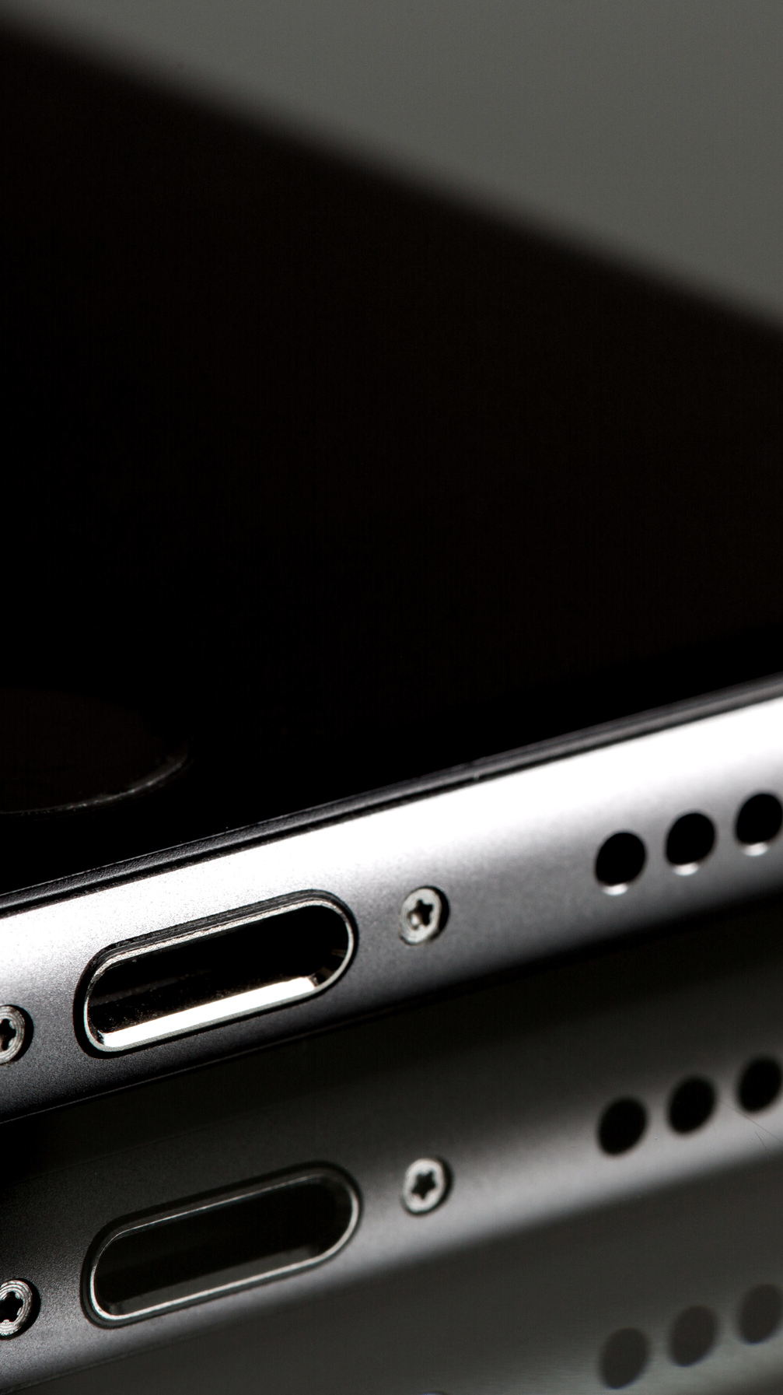


MODULES
Gathering raw data
Marking ID on attributes
Training on attribute data
Testing through algorithm
Output the match result
Displaying Error (if any)

Slide 6
40
LIBRARIES & TOOLS USED
30
20
Keras
OpenCV
PyQt5
10
0
Item 1
Item 2
Item 3
Item 4
Item 5

Slide 7
Keras
Keras is an API designed for human beings, not machines. Keras follows best practices for reducing cognitive load: it offers consistent & simple APIs, it minimizes the number of user actions required for common use cases, and it provides clear & actionable error messages. It also has extensive documentation and developer guides.

Slide 8
OpenCV
OpenCV is a huge open-source library for computer vision, machine learning, and image processing. It can process images and videos to identify objects, faces, or even the handwriting of a human.
Using OpenCV it becomes easy to do complex tasks such as identify and recognize faces, identify objects, classify human actions in videos, track camera movements, track moving objects, extract 3D object models, and many more.

Slide 9
PyQt5
PyQt5 is one of the most used modules in building GUI apps in Python, and that's due to its simplicity as you will see.
Another great feature that encourages developers to use PyQt5 is the PyQt5 designer, which makes it so easy to develop complex GUI apps in a short time. You just drag your widgets to build your form.

Slide 10

Why OpenCV ?
Currently, various packages are present to perform machine learning, deep learning and computer vision tasks. By far, computer vision is the best module for such complex activities. OpenCV is an open-source library. It is supported by various programming languages such as Python. It runs on most of the platforms such as Windows, Linux and MacOS.
Advantages of OpenCV:
OpenCV is an open-source library and is free of cost.
As compared to other libraries, it is fast since it is written in C/C++.
It works on various OS like Windows, Linux, etc

Slide 11
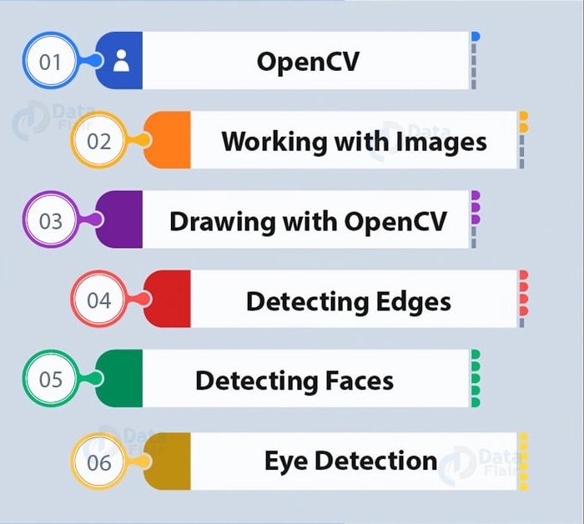
FACE DETECTION AND RECOGNITION
FROM IMAGE
Face recognition, as the names suggest includes detecting faces and then label them with the name of the person

Slide 12
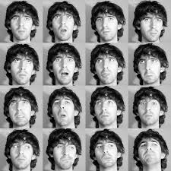
EIGENFACES
Eigenfaces is a method that is useful for face recognition and detection by determining the variance of faces in a collection of face images and use those variances to encode and decode a face in a machine learning way without the full information reducing computation and space complexity.
Face authentication and face identification are challenging problems. The fact that in the recent past, there have been more and more commercial, military and institutional applications, makes the face recognition systems a popular subject. To be reliable, such systems have to work with high precision and accuracy.

Slide 13
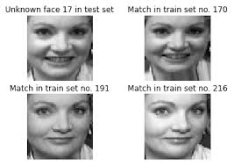
In a Face recognition system, the database consists of the images of the individuals that the system has to recognize. If possible, several images of the same individual should be included in the database. If the images are selected so that they account for varying facial expressions, lighting conditions, etc., the solution of the problem can be found more easily as compared to the case where only a single image of each individual is stored in the database.
A face recognition algorithm processes the captured image and compares it to the images stored in the database. If a match is found, then the individual is identified. If no match is found, then the individual is reported as unidentified.

Slide 14
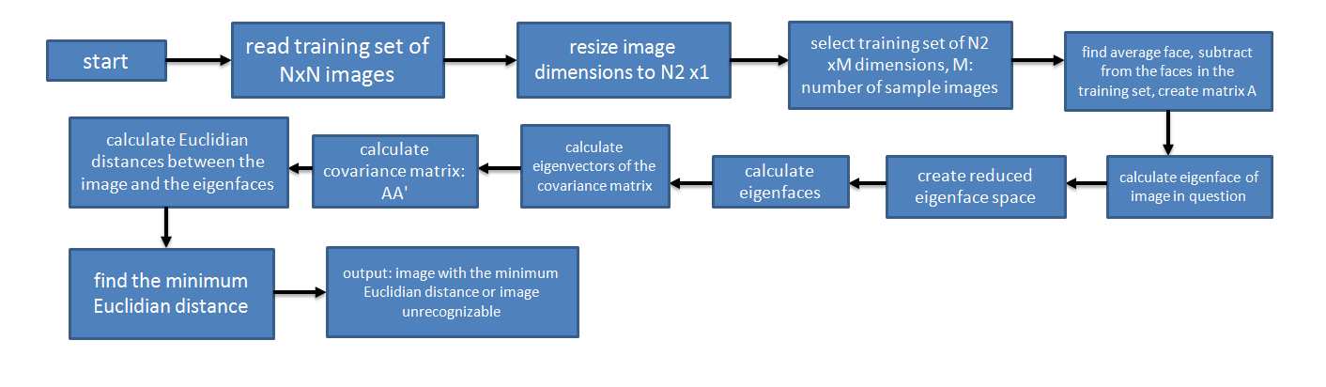

Flowchart of the algorithm of the Eigenfaces method
The challenges of face recognition are:
Shifting and scaling of the image
Differences in the facial look (different angle, pose, hairstyle, makeup, mustache, beard, etc.),
Lighting
Aging.

Slide 15
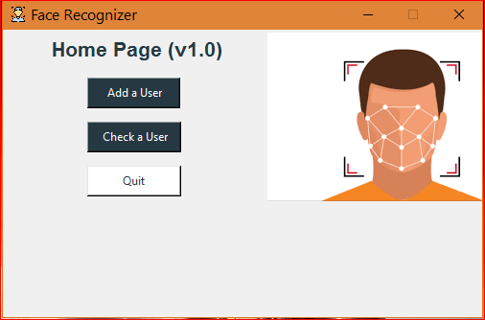
OUTPUTS
This is what the Home Page looks like

Slide 16
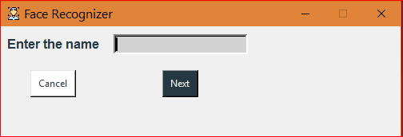
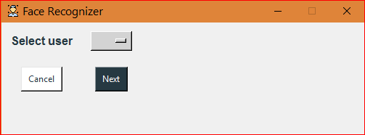
To create a new User
OR
Use an existing User

Slide 17
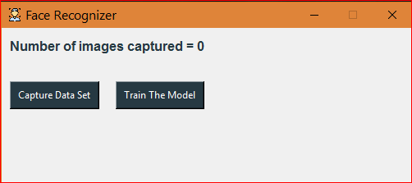
Capture a Dataset & start training the model!!

Slide 18
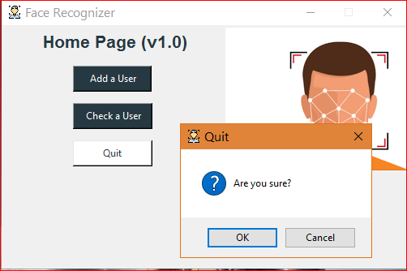
For when you’re done with everything

Slide 19




SCOPE OF OUR PROJECT
Implementation of this project in making various selections of authorization services or real-time attendance counter.

